Slide 1
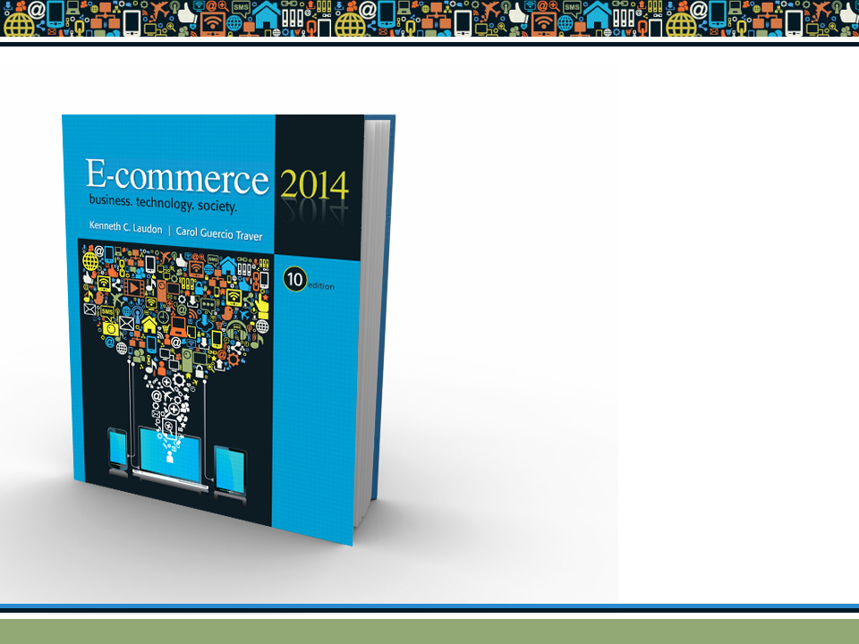
Copyright © 2014 Pearson Education, Inc. Publishing as Prentice Hall

Slide 2

Chapter 11
Social Networks, Auctions, and Portals
Copyright © 2014 Pearson Education, Inc. Publishing as Prentice Hall

Slide 3

Social Network Fever
Spreads to the Professions
How has the growth of social networks enabled the creation of more specific niche sites?
What are some examples of social network sites with a financial or business focus?
Describe some common features and activities on these social network sites.
What features of social networks best explain their popularity?
Copyright © 2014 Pearson Education, Inc. Publishing as Prentice Hall
Slide 11-<number>
Notes:
A niche site is a website dedicated to a very specific audience. Amazon for example is not a niche website because it sells products of every variety
Adgabber - is a social network for individuals in advertising, marketing and media
Duedee-Is a interactive community where you can connect with other investors to share ideas, collaborate and practice.
Tradeking - Is a social networking site that offers online brokerage services for active stocks and options traders. It was launched in December 2005
Daily strength.org – Is a social networking site where users provide each other with emotional support by discussing their struggles and successes with each other
Opportunity to Meet New People, Social Networking Sites are User-friendly, Join Groups that Share your Interests, They are Free to Use, Job Market, Helps Businesses to Reach Out

Slide 4
Social Networks and Online Communities
Internet began as communications medium for scientists
Early communities were bulletin boards, newsgroups (e.g., the Well)
Today social networks, photo/video sharing, blogs have created new era of online socializing
Social networks now one of most common Internet activities
Copyright © 2014 Pearson Education, Inc. Publishing as Prentice Hall
Slide 11-<number>

Slide 5
What Is an Online Social Network?
Working definition
  Group of people
  Shared social interaction
  Common ties
  Sharing an area for period of time
Portals and social networks:
  Moving closer together
  Community sites adding portal-like services
    Searching, news, e-commerce services
Copyright © 2014 Pearson Education, Inc. Publishing as Prentice Hall
Slide 11-<number>

Slide 6
The Growth of Social Networks and Online Communities
Top 10 social networks account for more than 90% social networking activity
Facebook users: More than 50% are 35+
Unique audience size:
  Top four U.S. social networks: 270 million
  Top four portal/search engines: 680 million
Annual advertising revenue
  U.S. social network sites: $4.45 billion
  Top four portal/search engines: $22 billion
Copyright © 2014 Pearson Education, Inc. Publishing as Prentice Hall
Slide 11-<number>

Slide 7
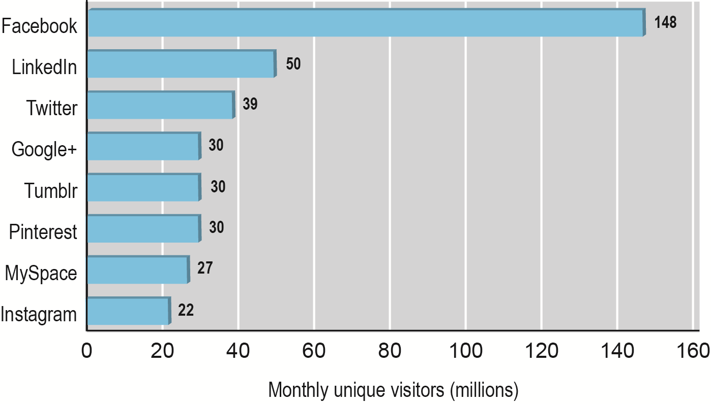
Top 10 Social Network Sites 2013
Figure 11.1, Page 696
SOURCES: Based on data comScore, 2013b
Copyright © 2014 Pearson Education, Inc. Publishing as Prentice Hall
Slide 11-<number>

Slide 8
Turning Social Networks
into Businesses
Social networks monetizing audiences through advertising
Business use of social networks
  Marketing and branding tool
    Facebook pages, “fans”
    Twitter feeds
  Reaching younger audience than Web sites and e-mail
  Listening tool
    Monitoring online reputation
  Extension of CRMs
Copyright © 2014 Pearson Education, Inc. Publishing as Prentice Hall
Slide 11-<number>

Slide 9
The Dark Side of Social Networks
How can businesses accurately judge whether negative comments are trolling or have merit and should be responded to?
Have you ever left a negative comment about a product or business? Have others’ negative comments influenced a purchase?
Should a business have any say in how an employee uses social networks outside of the office?
Copyright © 2014 Pearson Education, Inc. Publishing as Prentice Hall
Slide 11-<number>

Slide 10
Types of Social Networks
and Their Business Models
General communities:
  Offer opportunities to interact with general audience organized into general topics
  Advertising supported by selling ad space on pages and videos
Practice networks:
  Offer focused discussion groups, help, and knowledge related to area of shared practice
  May be profit or nonprofit; rely on advertising or user donations
Copyright © 2014 Pearson Education, Inc. Publishing as Prentice Hall
Slide 11-<number>
Notes:
General communities: Online social gathering place to meet and socialize with friends, share content, schedules, and interests. Examples: Facebook, Pinterest, Tumblr, and Twitter.
Practice networks: Social network of professionals and practitioners, creators of artifacts such as computer code or music. Examples: Just Plain Folks (musicians’ community) and LinkedIn (business). . For instance, Linux.org is a nonprofit community for the open source movement, a worldwide global effort involving
thousands of programmers who develop computer code for the Linux operating system and share the results freely with all.

Slide 11
Types of Social Networks
and Their Business Models (cont.)
Interest-based social networks:
  Offer focused discussion groups based on shared interest in some specific subject
  Usually advertising supported
Affinity communities:
  Offer focused discussion and interaction with other people who share same affinity (self or group identification)
  Advertising and revenues from sales of products
Sponsored communities:
  Created by government, nonprofit, or for-profit organizations for purpose of pursuing organizational goals
Copyright © 2014 Pearson Education, Inc. Publishing as Prentice Hall
Slide 11-<number>
Notes:
Community built around a common interest, such as games, sports, music, stock markets, politics, health, finance, foreign affairs, or lifestyle. Examples: E-democracy.org (political discussion group) and PredictWallStreet (stock market site).
Affinity communities: Communities that are based on profession, common interest, cause, demographic, or marketer generated phenomenon.
Community of members who self-identify with a demographic or geographic category, such as women, African Americans, or Arab Americans. Examples: BlackPlanet (African American community and social network site) and iVillage
(focusing on women).
Sponsored communities: Network created by commercial, government, and nonprofit organizations for a variety of purposes. Examples: Nike, IBM, Cisco, and political candidates.

Slide 12
Social Network Features
and Technologies
Profiles
Friends network
Network discovery
Favorites
Games, widgets, apps
E-mail
Storage
Instant messaging
Message boards
Online polling
Chat
Discussion groups
Experts online
Membership management tools
Copyright © 2014 Pearson Education, Inc. Publishing as Prentice Hall
Slide 11-<number>
Notes:
a small gadget or mechanical device.

Slide 13
The Future of Social Networks
Facebook’s growth has slowed
Growth of social networks focused on specific shared interests
Network fatigue
  Reuter study shows Facebook users spending less time on the site
Financial future
  Relationship between sales and Likes unclear
Copyright © 2014 Pearson Education, Inc. Publishing as Prentice Hall
Slide 11-<number>
Notes:
“social network fatigue,” where users are simply getting tired of following and updating their Facebook, Twitter, Tumblr, and LinkedIn networks.
But social networks are not yet proven advertising platforms that drive sales.
The relationship between Likes and sales is not clear yet. Response rates to display ads
on Facebook are far lower than on portal sites like Yahoo, or search ads like Google. In
part this reflects the sentiment of users who go onto social sites without the intention
of purchasing anything.

Slide 14
Facebook Has Friends
What does Mark Zuckerberg, Facebook’s CEO, mean by the “social graph”?
Why have Facebook applications become so popular? Do they have any limitations?
What are the core differences between Google+ and Facebook? Does Google+ offer significant advantages?
How has Microsoft responded?
Is Tumblr a significant competitor? Why or why not?
Copyright © 2014 Pearson Education, Inc. Publishing as Prentice Hall
Slide 11-<number>
Notes:
A social graph is a diagram that illustrates interconnections among people, groups and organizations in a social network. The term is also used to describe an individual's social network.

Slide 15
Online Auctions
Online auction sites are among the most popular C2C sites on the Internet
eBay: Market leader
Several hundred different auction sites in United States alone
Established portals and online retail sites increasingly are adding auctions to their sites
Copyright © 2014 Pearson Education, Inc. Publishing as Prentice Hall
Slide 11-<number>
Notes:
markets in which prices are variable and based on the competition among participants who are buying or selling products and services.

Slide 16
Defining and Measuring the Growth of Auctions and Dynamic Pricing
Dynamic pricing
  Airline tickets, coupons, college scholarships
  Prices based on demand characteristics of customer and supply situation of seller
Many types of dynamic pricing
  Bundling
  Trigger pricing
  Utilization pricing
  Personalization pricing
Copyright © 2014 Pearson Education, Inc. Publishing as Prentice Hall
Slide 11-<number>
Notes:
dynamic pricing the price of the product varies, depending directly on the demand characteristics of the customer and the supply situation of the seller.
Bundling: bundling of digital goods is the practice of including low-demand products in a bundle “for free” in order to increase total revenues.
Trigger pricing: Trigger pricing, used in m-commerce applications, adjusts prices based on the location of the consumer—for example, walking within 400 yards of a restaurant may trigger an immediate 10% dinner coupon on a portable Web device.
Utilization pricing adjusts prices based on utilization of the product; for example, Progressive Insurance Company adjusts the annual cost of automobile insurance based on mileage driven.
Personalization pricing adjusts prices based on the merchant’s estimate of how much the customer truly values the product; for instance, Web merchants may charge committed fans of a musician higher prices for the privilege of receiving a new DVD before its official release to retail stores.

Slide 17
Defining and Measuring the Growth of Auctions and Dynamic Pricing (cont.)
Auctions: Type of dynamic pricing
  C2C auctions
    Auction house an intermediary
  B2C auctions
    Business owns assets; often used for excess goods
  Can be used to
    Sell goods and services
    Allocate resources
    Allocate and bundle resources
Copyright © 2014 Pearson Education, Inc. Publishing as Prentice Hall
Slide 11-<number>
Notes:
Consumer-to-consumer (C2C) auctions, in which the auction house is simply an intermediary market maker, providing a forum where consumers—buyers and sellers—can discover prices and trade.
business-to-consumer (B2C) auctions, where a business
owns or controls assets and uses dynamic pricing to establish the price. Established merchants on occasion use B2C auctions to sell excess goods.

Slide 18
Benefits of Auctions
Liquidity
Price discovery
Price transparency
Market efficiency
Lower transaction costs
Consumer aggregation
Network effects
Copyright © 2014 Pearson Education, Inc. Publishing as Prentice Hall
Slide 11-<number>
Notes:
Liquidity: Sellers can find willing buyers, and buyers can find sellers. buyers and sellers can find a global market for rare items that would not have existed before the Internet.
Price discovery: Buyers and sellers can quickly and efficiently develop prices for items that are difficult to assess, where the price depends on demand and supply, and where the product is rare.
Price transparency: Public Internet auctions allow everyone in the world to see the asking and bidding prices for items.
Market efficiency: Auctions can, and often do, lead to reduced prices, and hence reduced profits for merchants, leading to an increase in consumer welfare—one measure of market efficiency.
Lower transaction costs: Online auctions can lower the cost of selling and purchasing products, benefiting both merchants and consumers.
Consumer aggregation: Sellers benefit from large auction sites’ ability to aggregate a large number of consumers who are motivated to purchase something in one marketspace.
Network effects: The larger an auction site becomes in terms of visitors and products for sale, the more valuable it becomes as a marketplace for everyone by providing liquidity and several other benefits listed previously, such as lower transaction costs, higher efficiency, and better price transparency.

Slide 19
Risks and Costs of Auctions for
Consumers and Businesses
Delayed consumption costs
Monitoring costs
  Possible solutions include:
    Fixed pricing
    Watch lists
    Proxy bidding
Equipment costs
Trust risks
  Possible solution—rating systems
Fulfillment costs
Copyright © 2014 Pearson Education, Inc. Publishing as Prentice Hall
Slide 11-<number>
Notes:
Delayed consumption costs: Internet auctions can go on for days, and shipping will take additional time. If you ordered from a mail-order catalog, you would likely receive the product much faster, or if you went to a physical store, you would immediately be able to obtain the product.
Monitoring costs: Participation in auctions requires your time to monitor bidding.
Equipment costs: Internet auctions require you to purchase a computer system, pay for Internet access, and learn a complex operating system.
Trust risks: Online auctions are the single largest source of Internet fraud. Using auctions increases the risk of experiencing a loss.
Fulfillment costs: Typically, the buyer pays fulfillment costs of packing, shipping, and insurance, whereas at a physical store these costs are included in the retail price.

Slide 20
Market-Maker Benefits
No inventory
No fulfillment activities
  No warehouses, shipping, or logistical facilities
eBay makes money from every stage in auction cycle
  Transaction fees
  Listing fees
  Financial services fees
  Advertising or placement fees
Copyright © 2014 Pearson Education, Inc. Publishing as Prentice Hall
Slide 11-<number>
Notes:
Auction sites carry no inventory and do not perform any fulfillment activities—they need no warehouses, shipping, or logistical facilities. Sellers and consumers provide these services and bear these costs. In this sense, online auctions are an ideal digital business because they involve simply the transfer of information.
eBay earns revenue from auctions in several ways: transaction fees based on the amount of the sale, listing fees for display of goods, financial service fees from payment systems such as PayPal, and advertising or placement fees where sellers pay extra for special services such as particular display or listing services.

Slide 21
Internet Auction Basics
Different from traditional auctions
  Last much longer (usually a week)
  Variable number of bidders who come and go from auction arena
Market power and bias in dynamically priced markets
  Neutral: Number of buyers and sellers is few or equal
  Seller bias: Few sellers and many buyers
  Buyer bias: Many sellers and few buyers
Fair market value
Copyright © 2014 Pearson Education, Inc. Publishing as Prentice Hall
Slide 11-<number>
Notes:
Fair market value could be defined here as the average of prices for that product or service in a variety of dynamic and fixed-price markets around the world. We explore other auction market failures in a later section.

Slide 22
Internet Auction Basics (cont.)
Price Allocation Rules
  Uniform pricing rule: Multiple winners who all pay the same price
  Discriminatory pricing rule: Winners pay different amount depending on what they bid
Public vs. private information
  Prices bid may be kept secret
    Bid rigging
  Open markets
    Price matching
Copyright © 2014 Pearson Education, Inc. Publishing as Prentice Hall
Slide 11-<number>

Slide 23
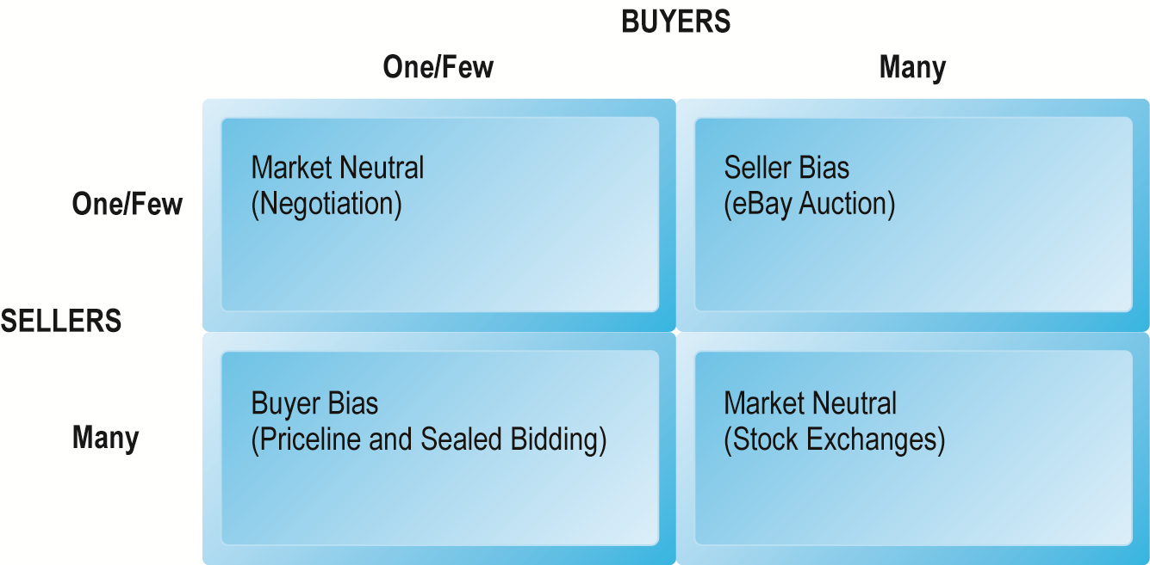
Bias in Dynamically Priced Markets
Figure 11.3, Page 715
Copyright © 2014 Pearson Education, Inc. Publishing as Prentice Hall
Slide 11-<number>

Slide 24
Types of Auctions
English auctions:
  Single item up for sale to single seller
  Highest bidder wins
Traditional Dutch auction:
  Uses a clock that displays starting price
  Clock ticks down price until buyer stops it
Dutch Internet auction:
  Public ascending price, multiple units
  Final price is lowest successful bid, which sets price for all higher bidders
Copyright © 2014 Pearson Education, Inc. Publishing as Prentice Hall
Slide 11-<number>
Notes:
The English auction is the easiest to understand and the most common form of auction on eBay. Typically, there is a single item up for sale from a single seller. There is a time limit when the auction ends, a reserve price below which the seller will not sell (usually secret), and a minimum incremental bid set. Multiple buyers bid against one another until the auction time limit is reached.
Traditional Dutch Auctions In the traditional Dutch auction in Aalsmeer, Holland,
5,000 flower growers—who own the auction facility—sell bundles of graded flowers to 2,000 buyers. The Dutch auction uses a clock visible to all that displays the starting price growers want for their flowers. Every few seconds, the clock ticks to a lower price. When buyers want to buy at the displayed price, they push a button to accept the lot of flowers at that price. If buyers fail to bid in a timely fashion, their competitors will win the flowers. The auction is very efficient: on average, Aalsmeer conducts 50,000 transactions daily for 20 million flowers. Dutch flower auctions are now conducted over the Internet.

Slide 25
Types of Auctions (cont.)
Name Your Own Price Auctions
  Users specify what they are willing to pay for goods or services and multiple providers bid for their business
  Prices do not descend and are fixed
    Consumer offer is commitment to buy at that price
  Enables sellers to unload unsold excess capacity
  Example: Priceline
Copyright © 2014 Pearson Education, Inc. Publishing as Prentice Hall
Slide 11-<number>

Slide 26
Types of Auctions (cont.)
Group buying auctions (demand aggregators)
  Group buying of products at dynamically adjusted discount prices based on high volume purchases
  Two principles
    Sellers more likely to offer discounts to buyers purchasing in volume
    Buyers increase their purchases as prices fall
Professional service auctions
  Example: Elance.com
Copyright © 2014 Pearson Education, Inc. Publishing as Prentice Hall
Slide 11-<number>

Slide 27
Factors to Consider When Choosing Auctions
CONSIDERATIONS | DESCRIPTION
Type of product | Rare, unique, commodity, perishable
Stage of product life cycle | Early, mature, late
Channel-management issues | Conflict with retail distributors; differentiation
Type of auction | Seller vs. buyer bias
Initial pricing | Low vs. high
Bid increment amounts | Low vs. high
Auction length | Short vs. long
Number of items | Single vs. multiple
Price-allocation rule | Uniform vs. discriminatory
Information sharing | Closed vs. open bidding
Table 11.9, p 721
Copyright © 2014 Pearson Education, Inc. Publishing as Prentice Hall
Slide 11-<number>
Notes:
likely to decay or go bad quickly.------perishable
a raw material or primary agricultural product that can be bought and sold, such as copper or coffee.----------commodity
making or showing an unfair or prejudicial distinction between different categories of people or things, especially on the grounds of race, age, or sex.---discriminatory

Slide 28
Seller and Consumer
Behavior at Auctions
Seller profit: Auction length, and number of units at auction
Auction prices not necessarily the lowest
Unintended results of participating in auctions:
  Winner’s regret
  Seller’s lament
  Loser’s lament
Consumer trust an important motivating factor in auctions
Copyright © 2014 Pearson Education, Inc. Publishing as Prentice Hall
Slide 11-<number>
Notes:
Herd behaviour is a phenomenon in which individuals act collectively as part of a group, often making decisions as a group that they would not make as an individual. There are two generally accepted explanations of herd behaviour.

Slide 29
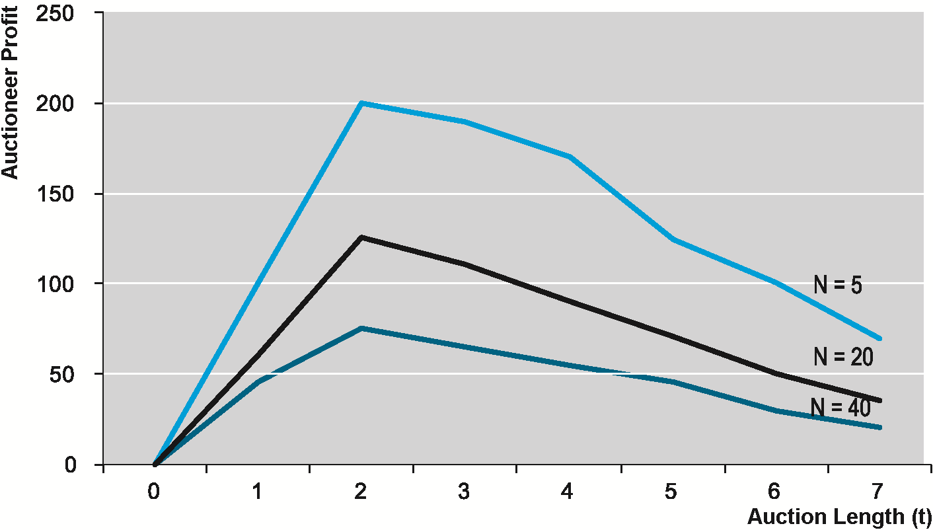
Auction Profits
Figure 11.4, Page 725
SOURCE: Based on data from Vakrat and Seidmann, 1998.
Copyright © 2014 Pearson Education, Inc. Publishing as Prentice Hall
Slide 11-<number>

Slide 30
When Auction Markets Fail:
Fraud and Abuse in Auctions
Markets fail to produce socially desirable outcomes in four situations:
  Information asymmetry
  Monopoly power
  Public goods
  Externalities
In 2012, Internet auction fraud is 10% of total Internet fraud
Copyright © 2014 Pearson Education, Inc. Publishing as Prentice Hall
Slide 11-<number>
Notes:
Online and offline auction markets can be prone to fraud, which produces information asymmetries between sellers and buyers and among buyers, which in turn causes auction markets to fail.
Monopoly power (also called market power) refers to a firm's ability to charge a price higher than its marginal cost. Monopoly power typically exists where the there is low elasticity of demand and significant barriers to entry.
A public good is a product that one individual can consume without reducing its availability to others and from which no one is deprived. Examples of public goods include law enforcement, national defense, sewer systems, and public parks.
An externality is a cost or benefit to a third party who has no control over how that cost or benefit was created. Externalities can be both positive or negative and can come from producing or consuming a good or service. Pollution is a common negative externality whose cost affects society as a whole.

Slide 31
E-commerce Portals
Most frequently visited sites on Web
Original portals were search engines
  As search sites, attracted huge audiences
Today provide:
  Navigation of the Web
  Commerce
  Content (owned and others’)
Compete on reach and unique visitors
Enterprise portals
  Help employees find important organizational content
Copyright © 2014 Pearson Education, Inc. Publishing as Prentice Hall
Slide 11-<number>

Slide 32
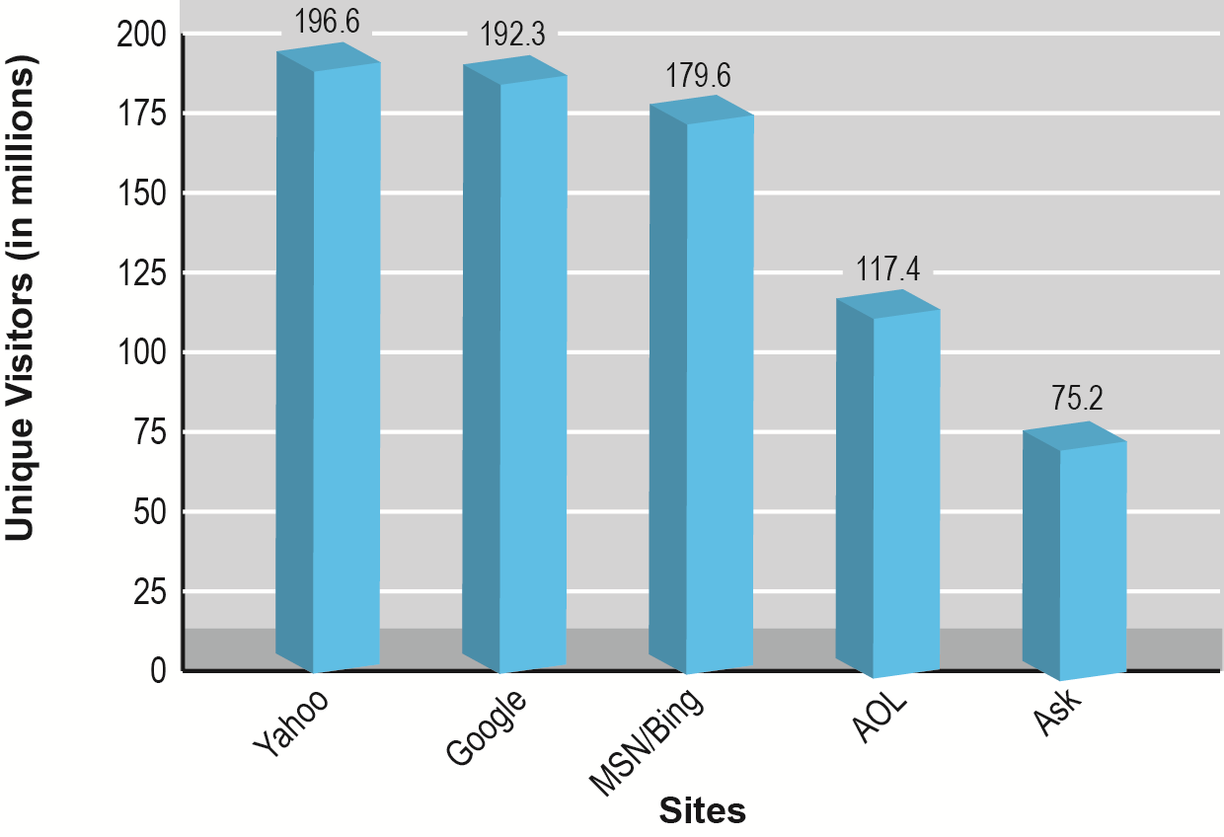
Top Five Portal/Search Engines in United States
Figure 11.5, Page 728
SOURCE: Based on data from comScore, 2011.
Copyright © 2014 Pearson Education, Inc. Publishing as Prentice Hall
Slide 11-<number>

Slide 33
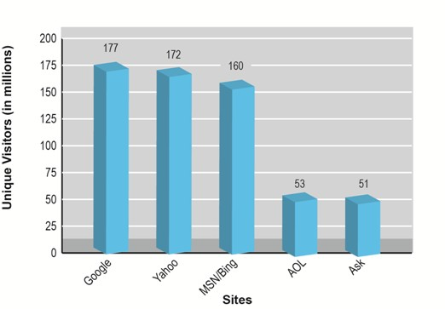

Slide 34
Types of Portals
General purpose portals:
  Attempt to attract very large general audience
  Retain audience by providing in-depth vertical content channels
  Example: Yahoo, MSN
Vertical market portals:
  Attempt to attract highly-focused, loyal audiences with specific interest in:
    Community (affinity group): for example, iVillage
    Focused content: for example, ESPN.com
Copyright © 2014 Pearson Education, Inc. Publishing as Prentice Hall
Slide 11-<number>
Notes:
General-purpose portals attempt to attract a very large general audience
and then retain the audience on-site by providing in-depth vertical content channels,
such as information on news, finance, autos, movies, and weather. General-purpose
portals typically offer Web search engines, free e-mail, personal home pages, chat
rooms, community-building software, and bulletin boards. Vertical content channels on general-purpose portal sites offer content such as sports scores, stock tickers, health tips, instant messaging, automobile information, and auctions.
Vertical market portals (sometimes also referred to as destination sites or vortals)
attempt to attract highly focused, loyal audiences with a deep interest either in com-
munity or specialized content—from sports to the weather. In addition to their focused content, vertical market portals have recently begun adding many of the features found in general-purpose portals. For instance, in addition to being a social network, you can also think of Facebook as a portal—the home page for millions of users, and a gateway to the Internet. Facebook is an affinity group portal because it is based on friendships among people.

Slide 35
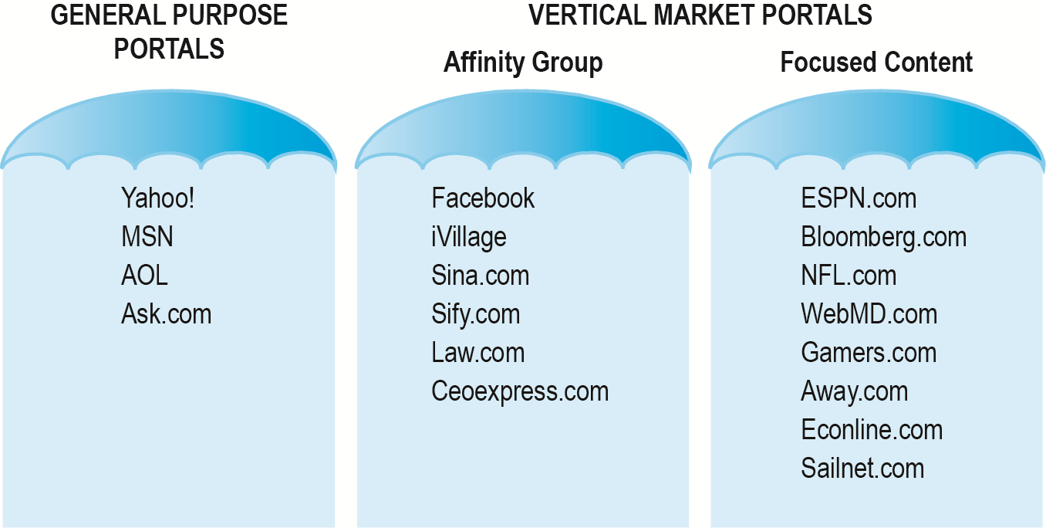
Two General Types of Portals:
General Purpose and Vertical Market Portals
Figure 11.6, Page 732
Copyright © 2014 Pearson Education, Inc. Publishing as Prentice Hall
Slide 11-<number>

Slide 36
Portal Business Models
General advertising revenue
Tenancy deals
  Fixed charge for number of impressions, exclusive partnerships, “sole providers”
Commissions on sales
Subscription fees
  Charging for premium content
Applications and games
Copyright © 2014 Pearson Education, Inc. Publishing as Prentice Hall
Slide 11-<number>
Notes:
A tenancy deal is the purchase of advertising space on an affiliate’s website. In most cases, the tenancy deal will be in addition to the traditional CPA agreement.

Slide 37
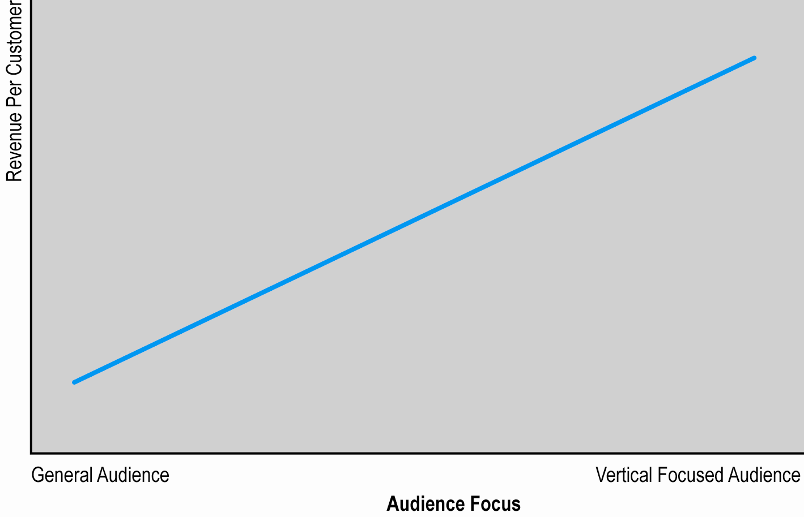
Revenue per Customer and Market Focus
Figure 11.7, Page 733
Copyright © 2014 Pearson Education, Inc. Publishing as Prentice Hall
Slide 11-<number>

Slide 38
Copyright © 2014 Pearson Education, Inc. Publishing as Prentice Hall
Slide 11-<number>

